Slide 1


Slide 1
Ocean Coffee
Monthly Sales Analysis

Slide 2


Slide 2
Introduction
Ocean Coffee is trying to find out how the company is doing for the month of April; hence a dashboard has been prepared to provide insights to the business.

Slide 3
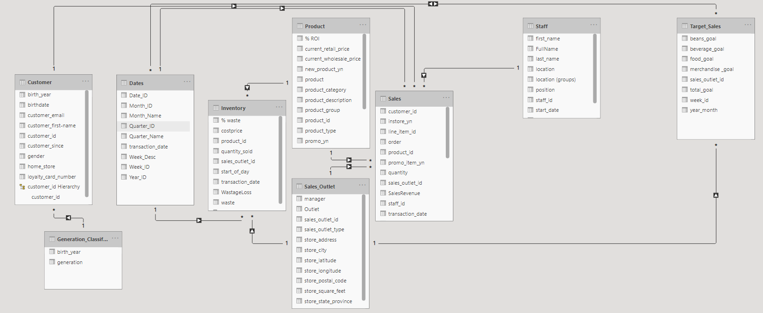

Slide 3
Database Schema

Slide 4
Slide 3
Dashboard – Insights
Sales
Customer
Data
Food Wastage
Employee

Slide 5
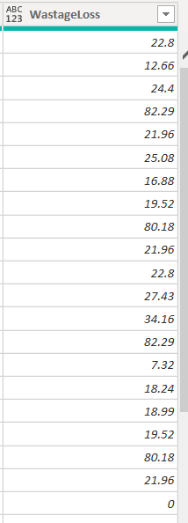
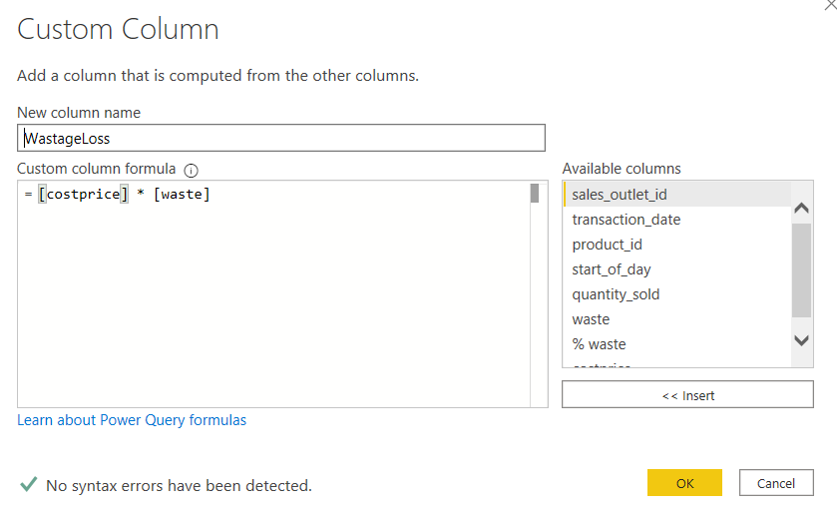
Slide 3
Data Preparation – Data Transformation

Slide 6
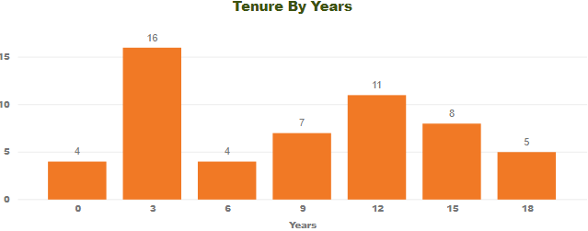
Slide 3
Data Preparation – Data Transformation

Slide 7
Slide 3
Dashboard - Insights
Sales Revenue has exceeded target by a large margin
Issue with pastry wastage
Most of the customers are from the morning crowd (7-11AM)
Main source of revenue : Beverage, Food and Bean/Teas.

Slide 8
Slide 3
Recommendations
Using the current data to prepare the number of pastries.
Having promotional bundles with popular beverage to entice customers
Allocating sufficient manpower to handle the peak hours.
R&D of new products – getting ideas from popular products(coffee/drinking chocolate)

Slide 9

Slide 15
THANK YOU!

